Slide 1
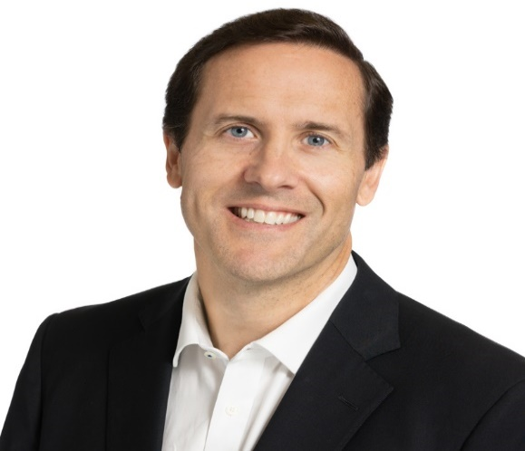
U.S. Immigration and Employment Options for International Postdocs and Graduate Students
12 noon (Eastern)
Friday, Feb 21st
Zoom presentation
About us: Led by Tom and Jim Arkell, the Arkell Immigration Team at Dunn Law Firm possesses decades of experience filing successful applications for U.S. permanent residence ('green cards') as well as U.S. citizenship. The team has represented dozens of leading universities in highly complex U.S. immigration matters and helped thousands of researchers, scientists and professors. The firm is an active member of the National Association of College and University Attorneys and of the American Immigration Lawyers Association.
Topics include:
U.S. permanent residence (‘green cards’)
National Interest Waivers for researchers and entrepreneurs
Extraordinary Ability petitions
Transitioning from F-1 OPT or J-1 status to H-1B, and ‘H-1B cap’ issues
Recent changes in U.S. immigration, executive orders and related issues
If you wish to have a free review of your credentials regarding U.S. permanent residence, please email your CV and Google Scholar profile to Dunn Law Firm Immigration Paralegal Kayla Clark at kayla@dunnlaw.com
Presented by:
Arkell Immigration Team
Dunn Law Firm, LLP
www.nationalinterestwaivers.com
and the Michigan State University Postdoctoral Association (MSU-PDA)
Zoom link

